Slide 1
Better Management of Bicycle Fleet

Slide 2
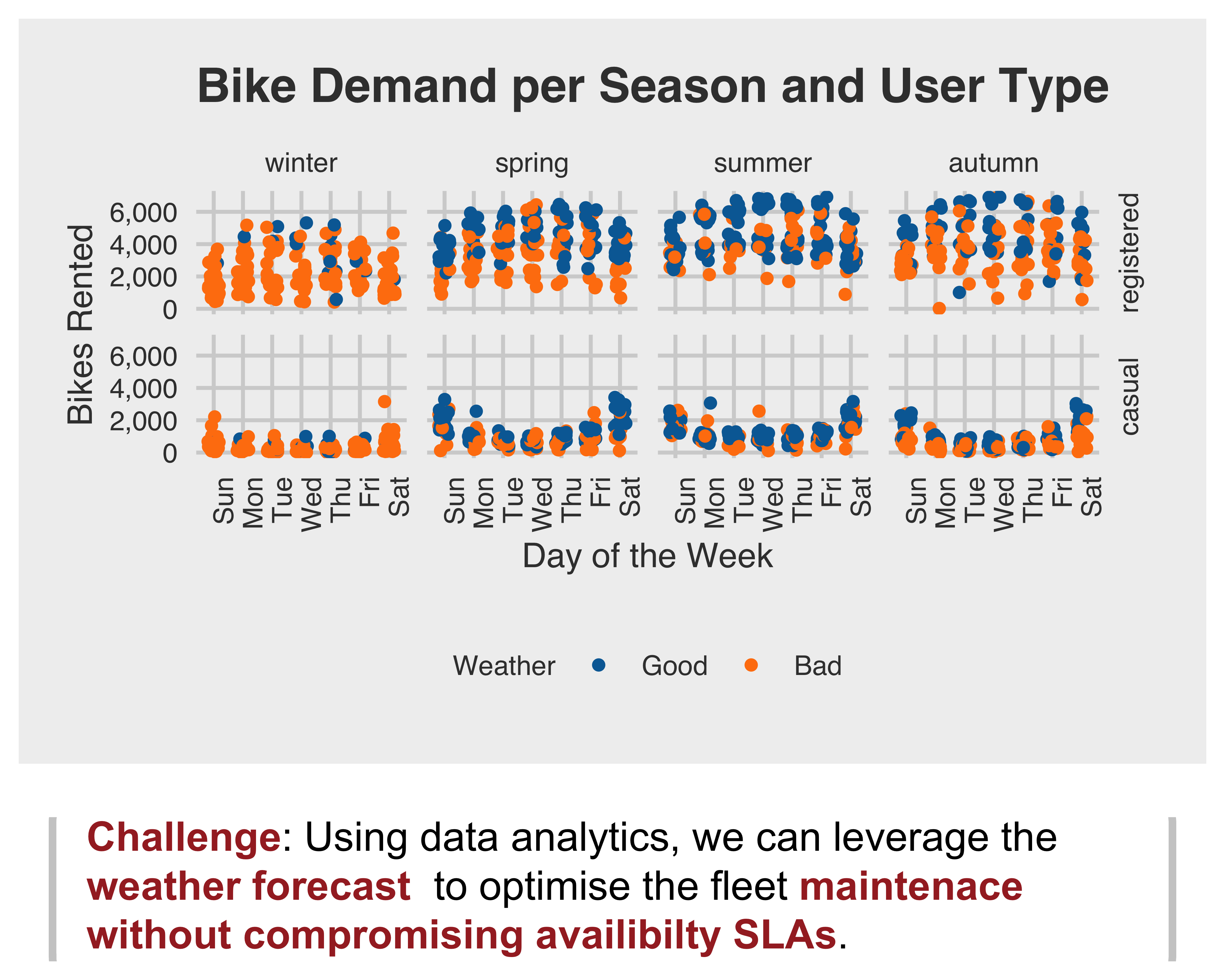
Fleet maintenance volumes and windows need to be carefully chosen
In order to provide a good service for the users of the bike sharing scheme, unavailability needs to be avoided, either by lack of maintenance or lack of supply. Thus, maintenance windows need to be selected smartly.
Shared bikes are used every day of the week. Registered users provide a constant demand baseline.
There is some seasonality in the demand: registered users brave through the winter keeping a the numbers high.
At first look, it seems that weather conditions are the biggest deterrent for bike usage. If it is too cold, or too hot or too windy casual users won’t ride; registered users’ numbers will also drop.
Bikes will keep breaking - even if they are well built! Thus, every opportunity to undertake maintenance needs to be taken.

